Slide 1
We have main page
That needs to have the login/register and create a page
Some welcoming message
Some links to pages (about, privacy, contact, condition)

Slide 2
We have dashboard
A registered user will acceed to dashboards where he can add his name and picture
In addition to that he can find find a button where to create a page

Slide 3
Building the page
Here we’ll have a scrolling list of elements (header, text paragraph, facebook like button,text field, youtube subscri….) that a user can drop on page
Here we have the page
This section will be for settings : when user cliks on element it shows its settings , example: for text it shows the text effects..
For youtube it shows links..
And for page it shows background color, background…

Slide 4
Page for builder side
Here user can get his page’s link to share
This page will contain the statistics about participants
When a page’s validity is ended (reached specific number of users or time ended)
A downloading data will be available here

Slide 5
Showing the page
Here we have the page + submit button
ads
ads
ads

Slide 6
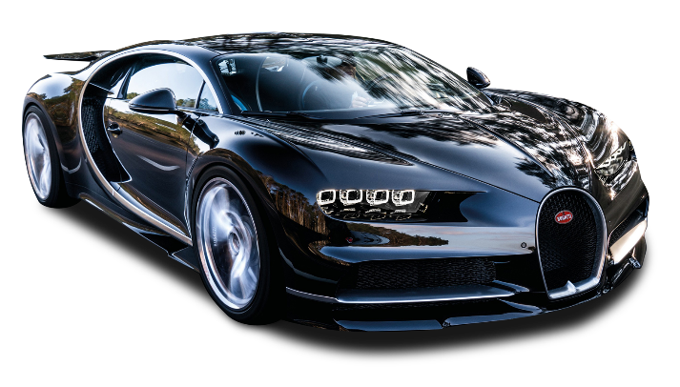
Final page
The prize is
And the winner is
PersonX
CLICK TO SHOW GIFT

